Slide 1
ISLA Leiria WP 4: Quality

Slide 2
Presentation Contents
1) Kick-off Meeting Evaluation feedback
2) Quality Plan
3) Meeting & training evaluation links
4) Managing the BSBN Training

Slide 3
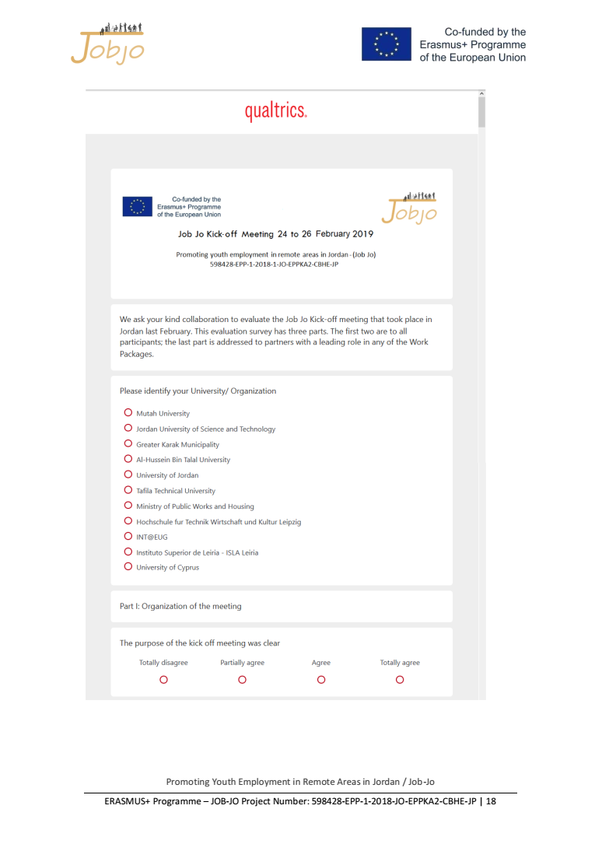
Kick-off Meeting Evaluation

Slide 4
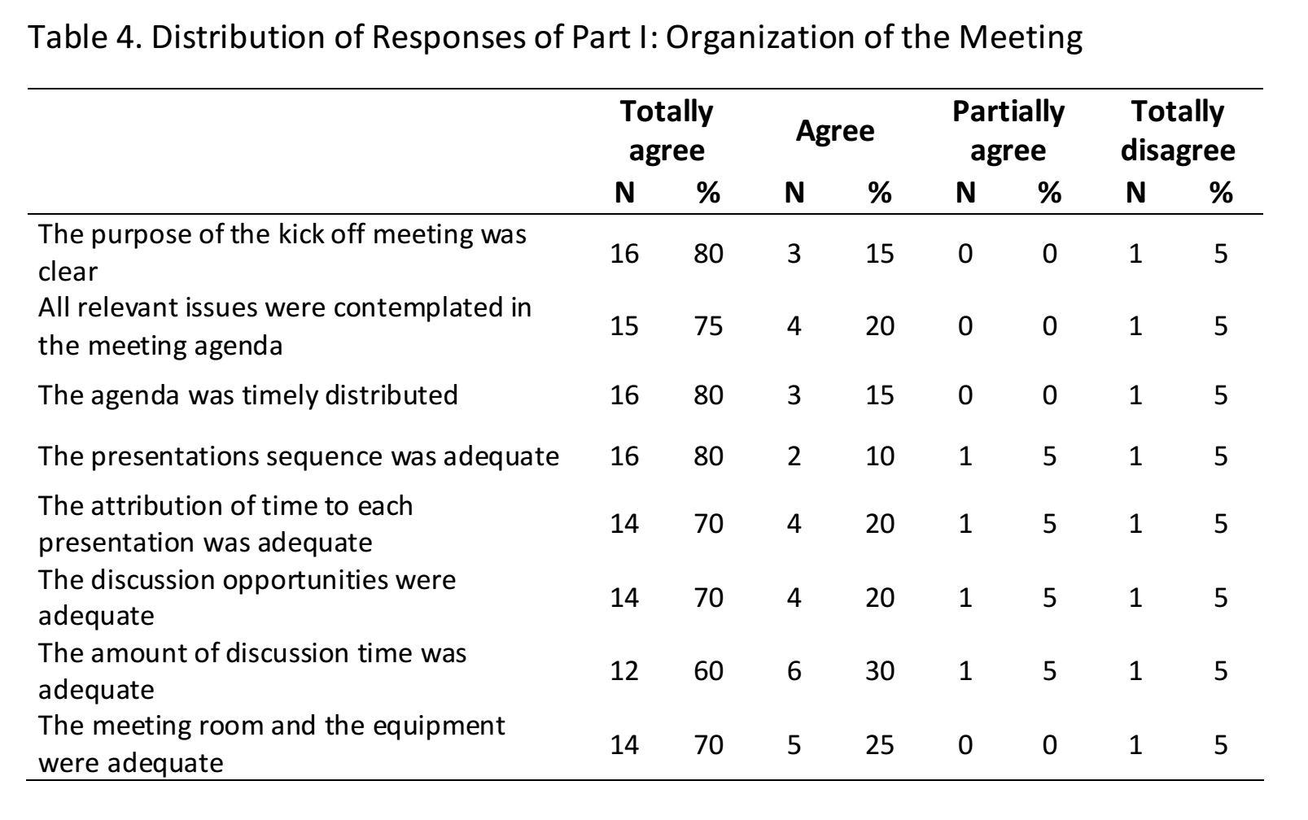
Meeting organization

Slide 5
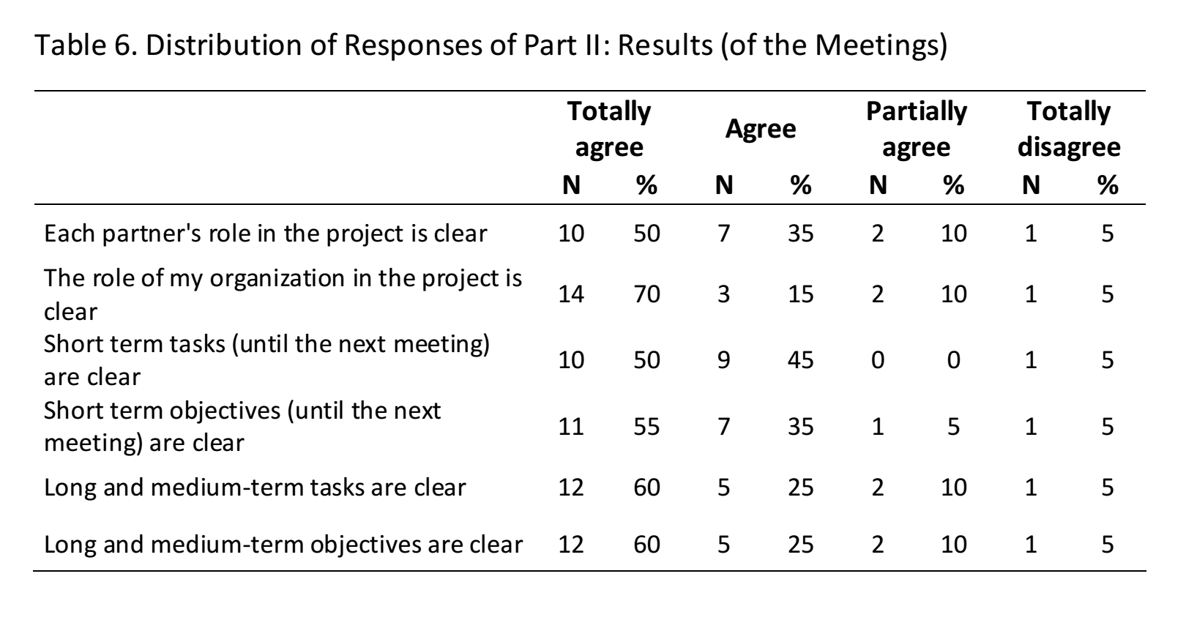
Meeting results

Slide 6
Meeting summary feedback
Global evaluation: positive
Main Proposals
A summary/minute should be made at the end of each working day; add discussion time;
Main constraints
Specification of due dates;
Clarification of each partners tasks

Slide 7
Quality Plan

Slide 8
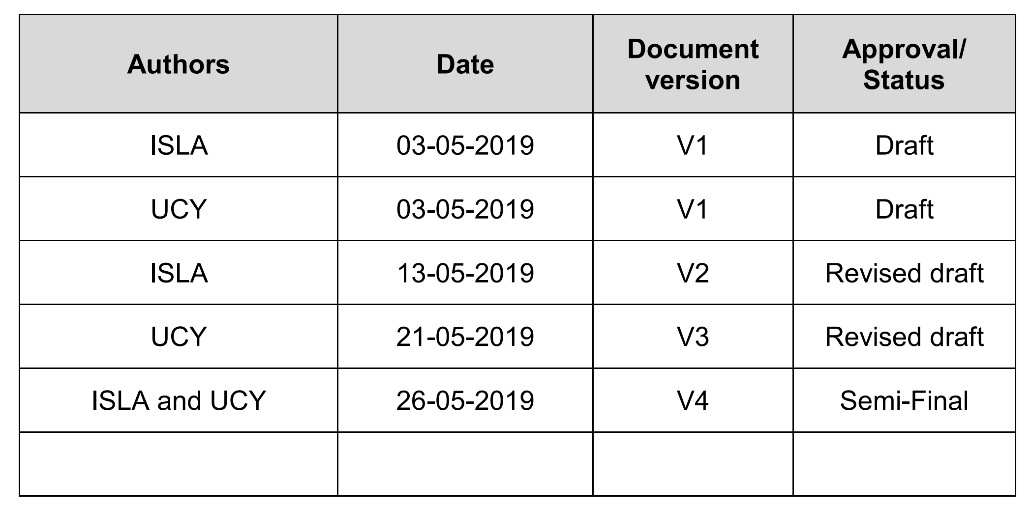
Quality Plan: development

Slide 9
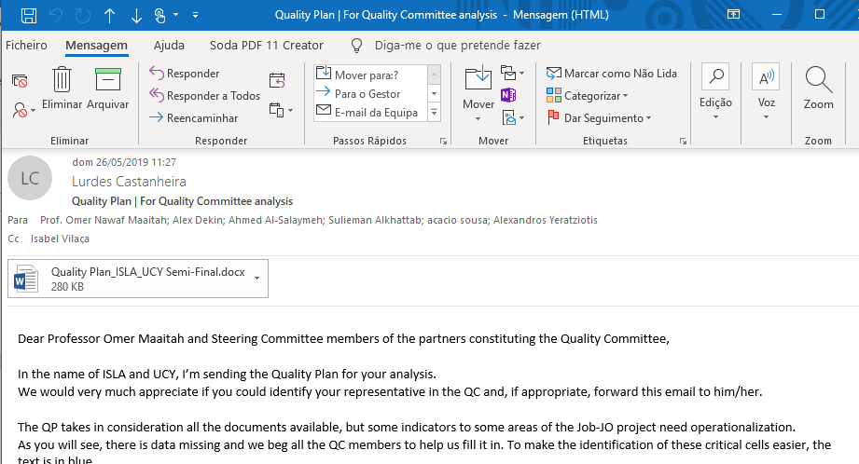
Quality Plan: development

Slide 10
Quality Plan: structure
1. Introduction 2. Quality of Coordination and Management
2.1. External Evaluation 3. Quality of Training Materials, Training Workshops and Reports
3.1. Peer Review Process 4. Quality of Dissemination 5. Risk Management Plan 5.1. List of Recommendations – Conflict Avoidance 6. Monitoring Working Time 7. Long Term Impact Indicators

Slide 11
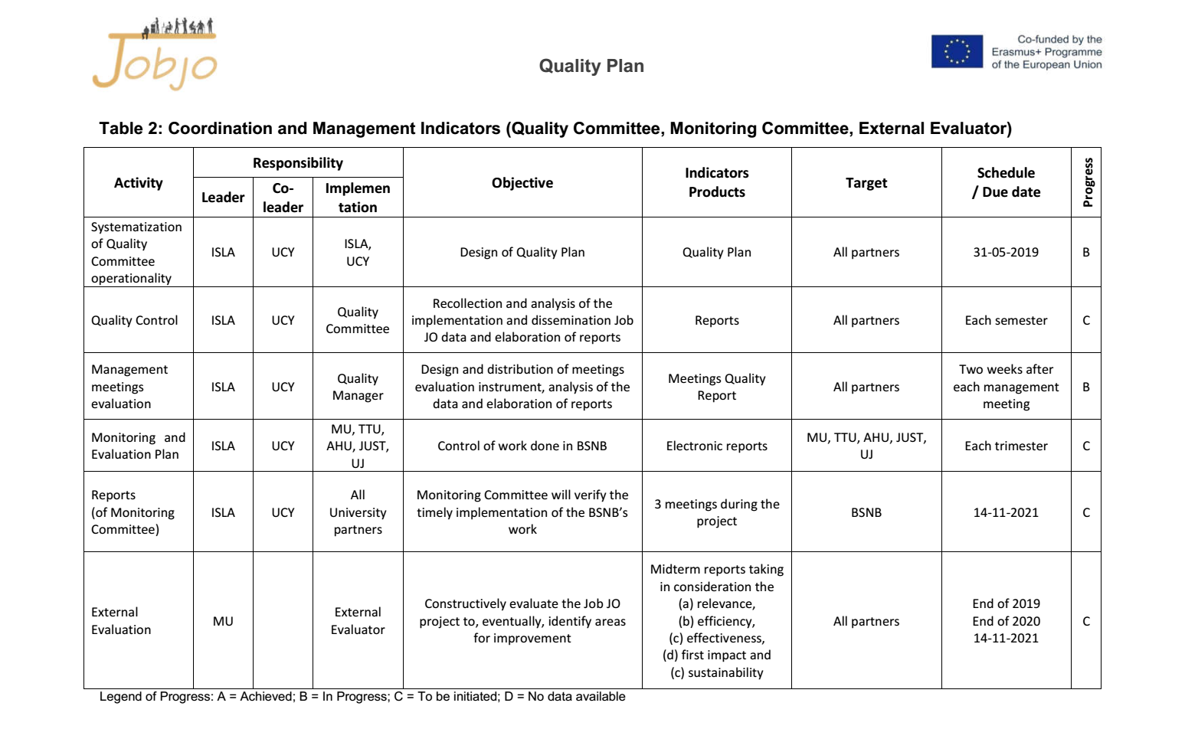
Quality Plan: structure operationalization

Slide 12
Quality Plan: summary
Coordination and Management Indicators
6 activities, 6 indicators and its due dates. All ok!
Training Indicators
6 activities, 8 indicators and its due dates. Needs specification: 2 sets of indicators and 1 due date
External Dissemination Indicators
5 activities, 6 indicators and its due dates. Needs specification: 1 partial indicator and 1 due date, missing
Internal Dissemination Indicators
4 activities, 4 indicators and its due dates. Needs specification: 1 due date
Long term indicators
Quantitative and qualitative.

Slide 13
Quality Plan: summary improvement needs
Coordination and Management Indicators
6 activities, 6 indicators and its due dates. All ok!
Training Indicators
6 activities, 8 indicators and its due dates. Needs specification: 2 sets of indicators and 1 due date
External Dissemination Indicators
5 activities, 6 indicators and its due dates. Needs specification: 1 partial indicator and 1 due date, missing
Internal Dissemination Indicators
4 activities, 4 indicators and its due dates. Needs specification: 1 due date
Long term indicators
Quantitative and qualitative.
2 sets of indicators and 1 due date
1 partial indicator and 1 due date
1 due date
Quantitative

Slide 14
Quality Manager
Main concerns
Quality Committee representatives
Availability of information to assess the quality
Channels of communication need to be specified.
Job Jo website private area?
Long term quantitative indicators specification
How many instructors; specification of minimum thresholds
Other concerns
Profile of trainees (trained by European partners)
Translation of training evaluation questionnaires to Arabic (Jordanian trainees)

Slide 15
Meeting and Training Evaluation
Links
Meeting: https://forms.gle/g4cZYqajDVUeaFu59
Training: https://forms.gle/H2aeYwQ8Lr2wegMd6
List of meeting participants and trainee email?

Slide 16
Managing the BSBN Training (ISLA, 2020)
Main concerns
Is our proposal accepted?
Who are the trainees?
Staff of BSBN?
Trainers of future trainees?
How many trainees?
Duration of the training?

